Slide 1
“Project Title”
Esaa Yamini, Juan Sebastian galindo , Avantika singh, Darren lucca, tommy ringo

Slide 2
Motivation/Questions

Slide 3

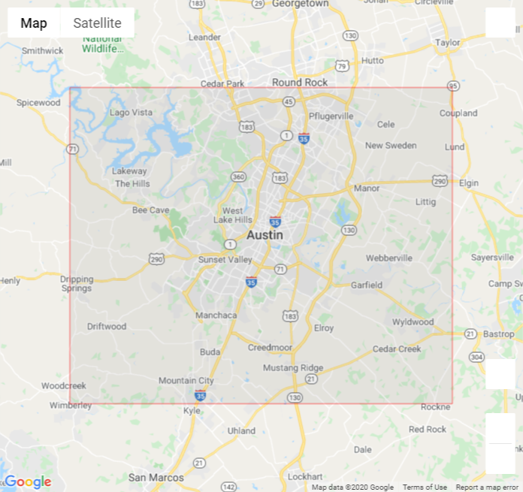
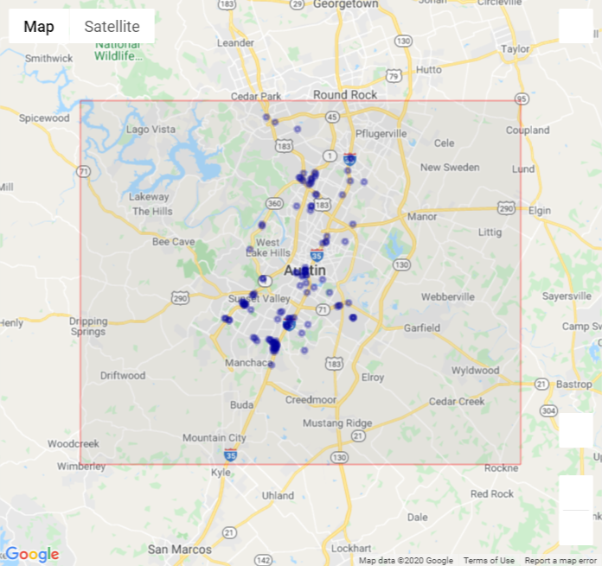
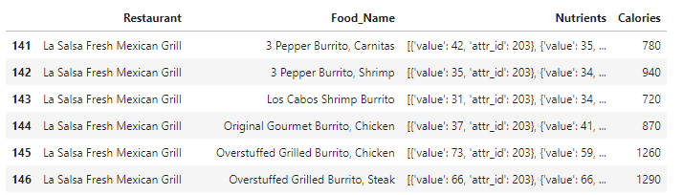
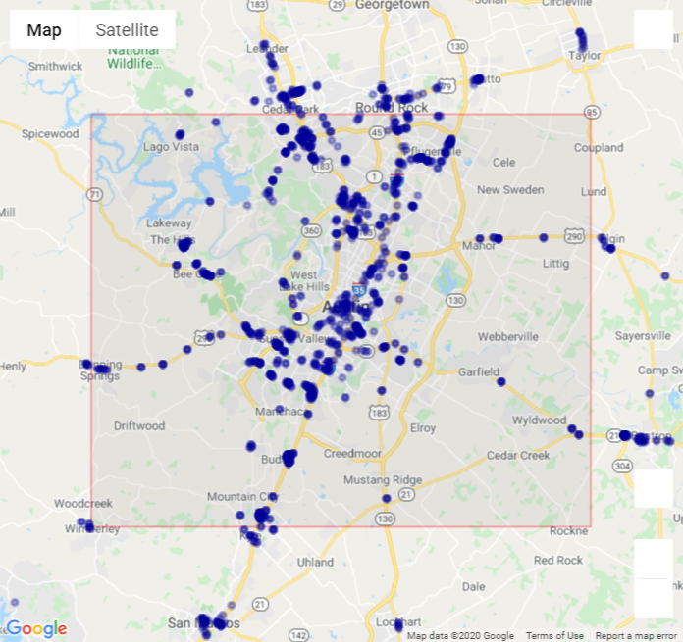
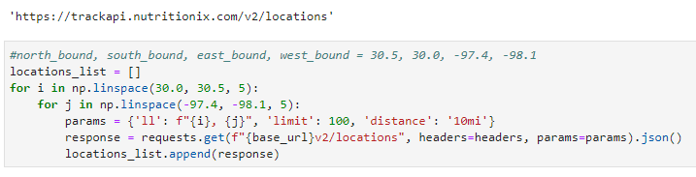
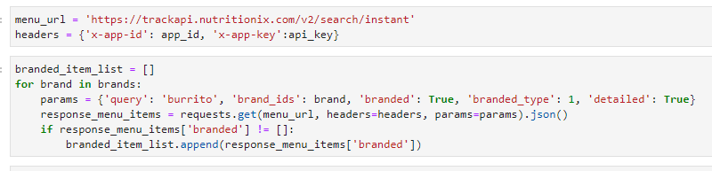
Data Retrieval
Set Boundary
API query for restaurant locations
Filter to unique locations in city
API query for nutrition details
121 locations
Location Query
Nutrition Query
1,433 locations

Slide 4
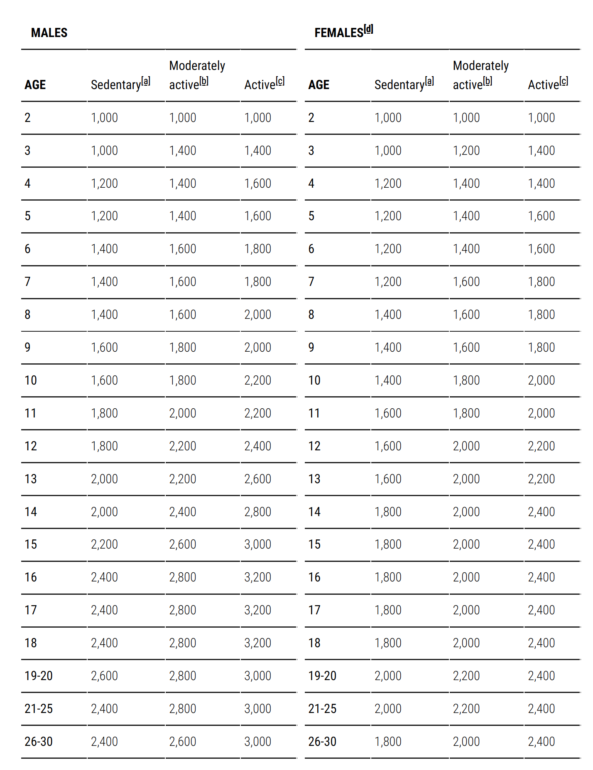
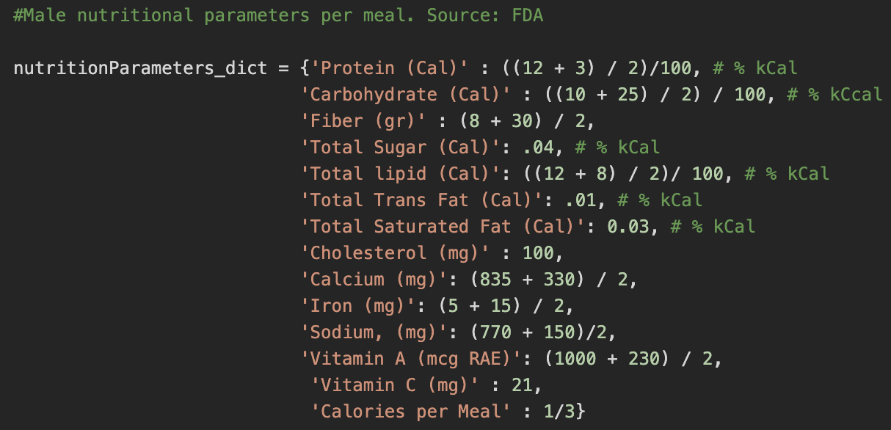
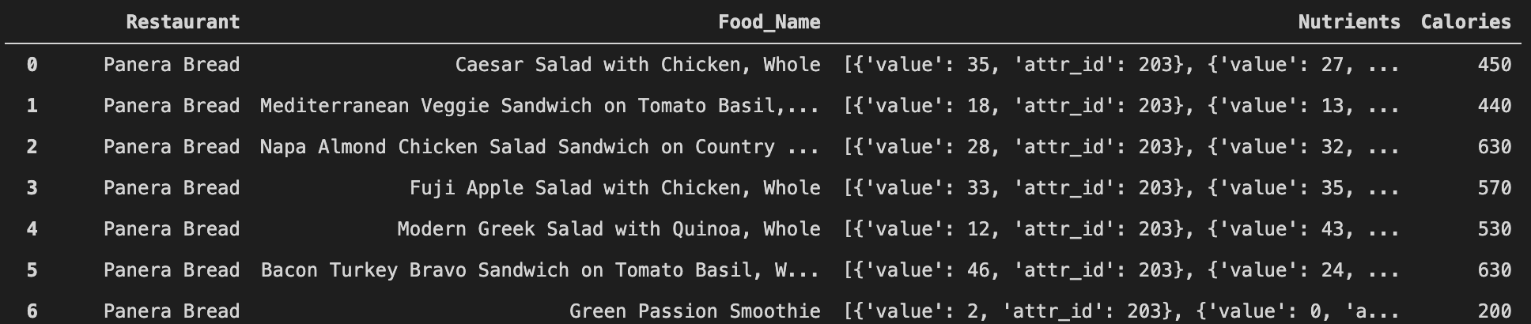
Data Processing
Raw data from the API request …. Ewww…..

Slide 5
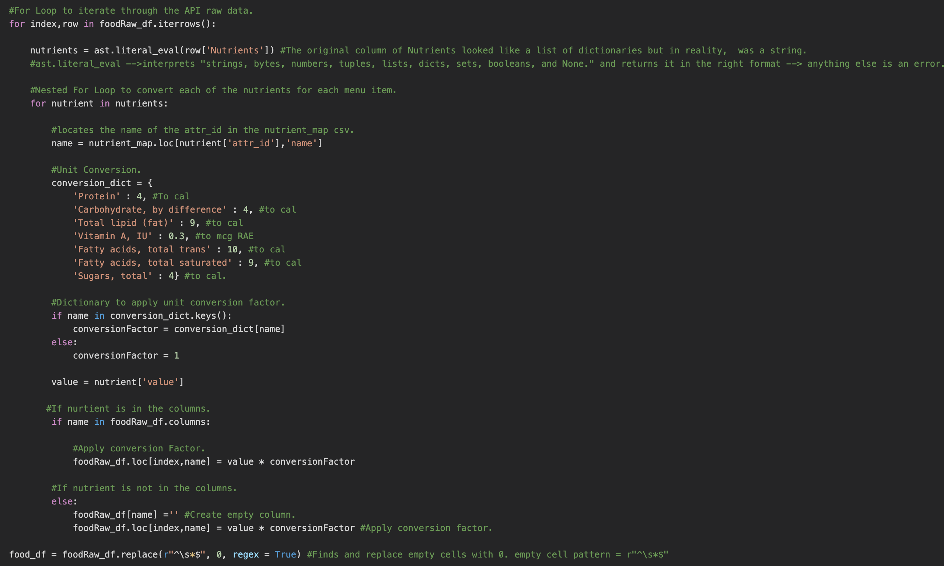
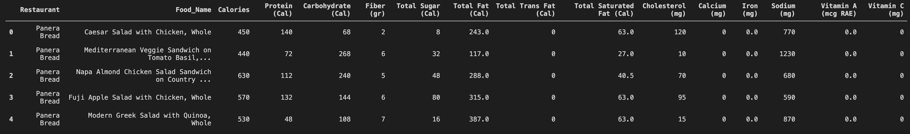
Menu Items Data Manipulation.

Slide 6
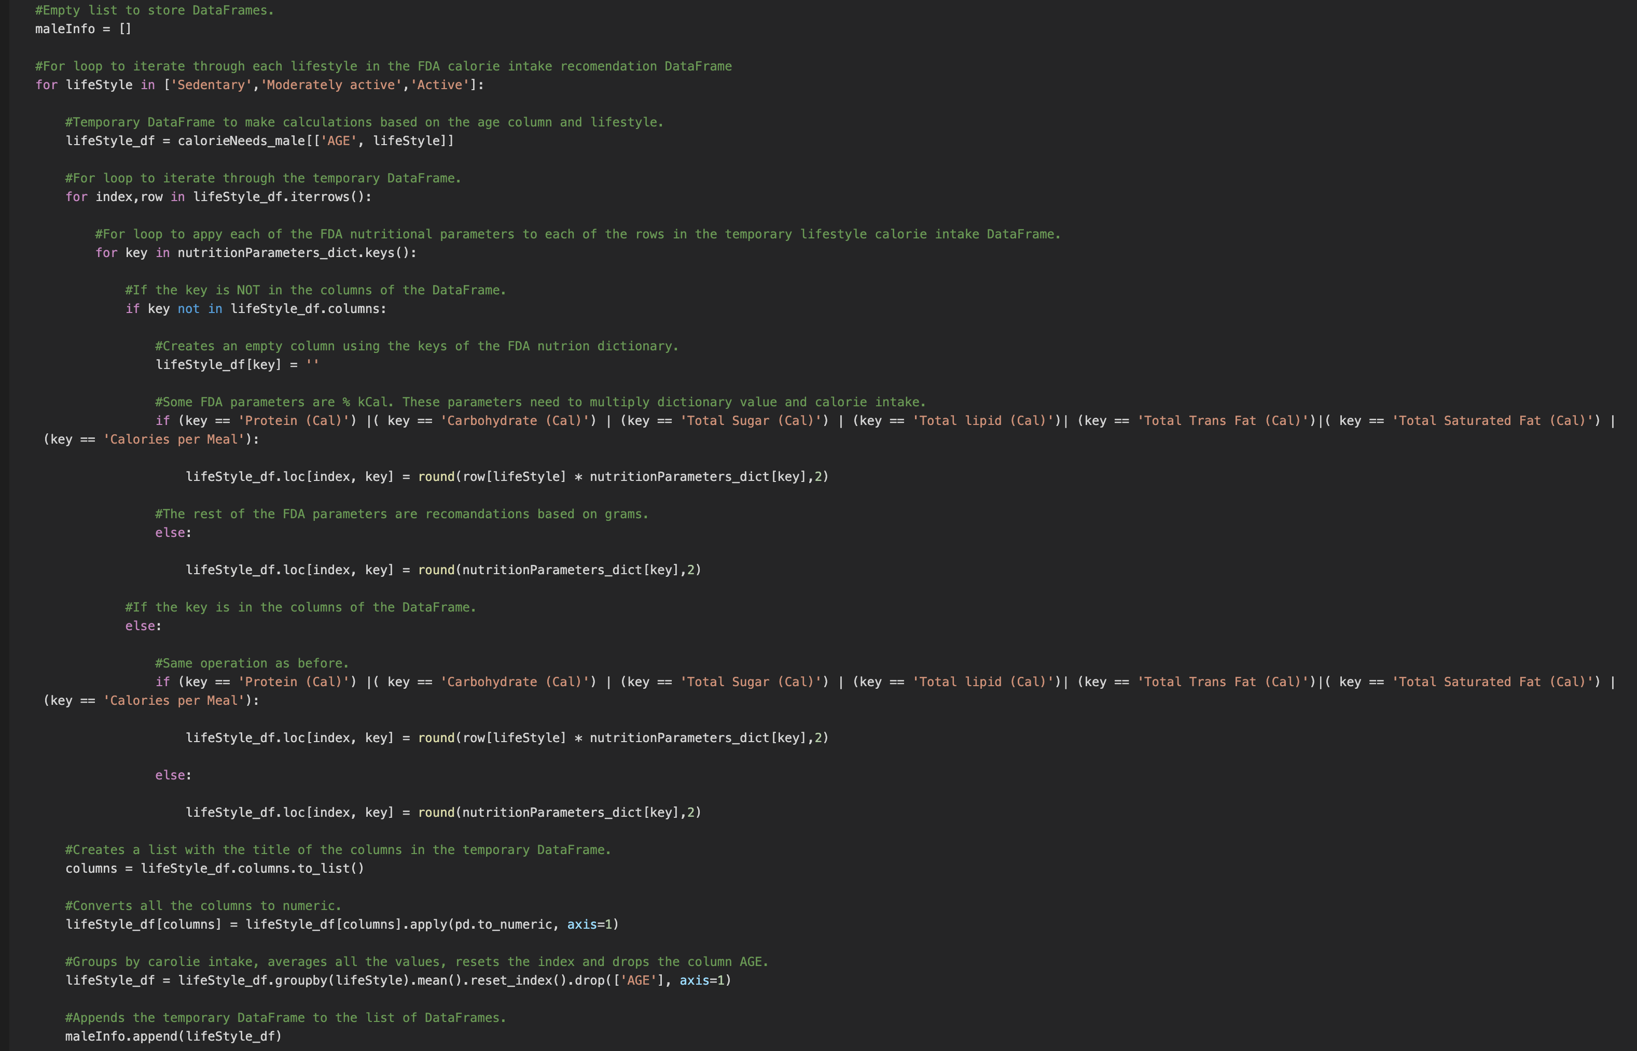
Calorie Intake and Nutritional Requirements.

Slide 7

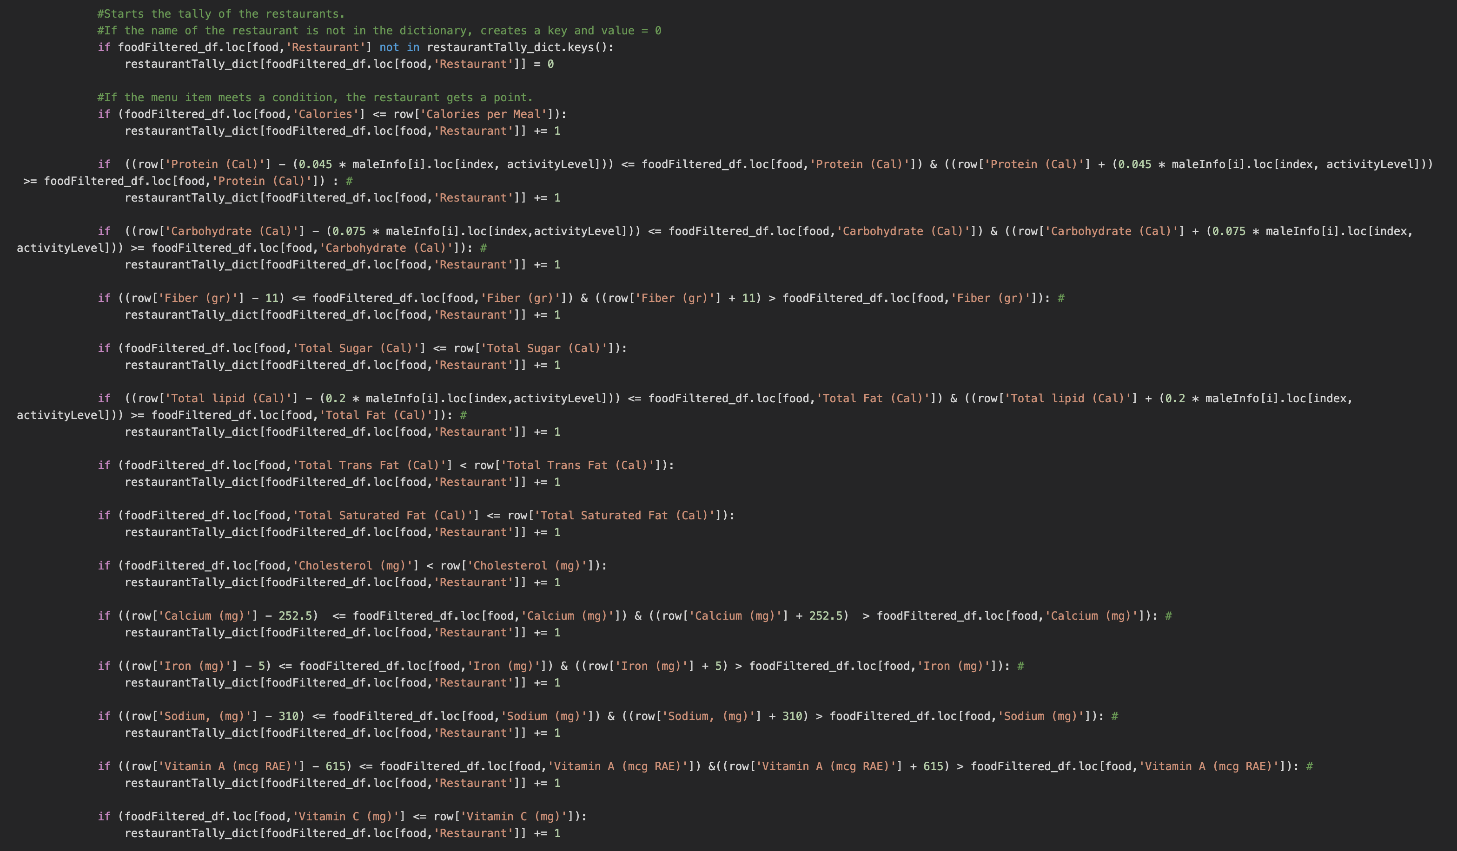
Point System.

Slide 8
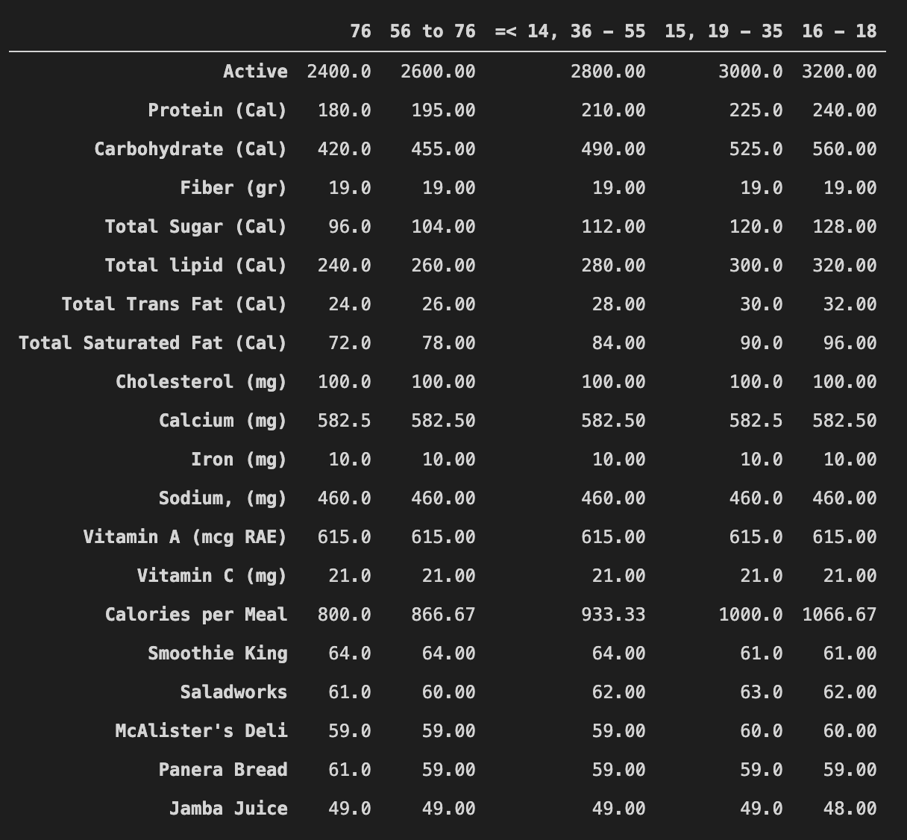
Final Output.

Slide 9
Analysis

Slide 10
Conclusions

